Slide 1

CS 456: Web Programming
Spring 2022
Lecture 05 – CSS

Slide 2
Summary
Introduction to CSS
Incorporating CSS in HTML pages
Basic Concepts
Common Properties
Common Practices
Principles of Web Design
Final Remarks

Slide 3
Introduction to CSS

Slide 4
What is CSS?
CSS – Cascade Style Sheet
Defines the formatting of how HTML elements will be displayed.
All formatting, coloring, and appearance design, should be placed in CSS.
Preferable in a separate CSS file, that way you can reuse the same style for multiple HTML pages.

Slide 5
Basic Syntax
Basic syntax of any CSS element is: property:value;
For example, to change the color, we use the property “color”; the value would be the RGB code or the color name. Therefore, to change the color to red we would use the following: color:#FF0000; or color:red;
If there is more than one property, we just need to put a semi-coma at the end of each: property1:value1;property2:value2;

Slide 6
Colors
Many properties will deal with colors.
The color can be the name of the color <https://www.w3schools.com/colors/colors_names.asp>
Examples: Red, Blue, Green, Black, White, Aquamarine, Azure, …
The color can also be the hexadecimal RGB code (6 digits) starting with #.
Examples: Red: #FF0000; Green: #00FF00; Blue:#0000FF; White:#FFFFFF; Black: #000000;

Slide 7
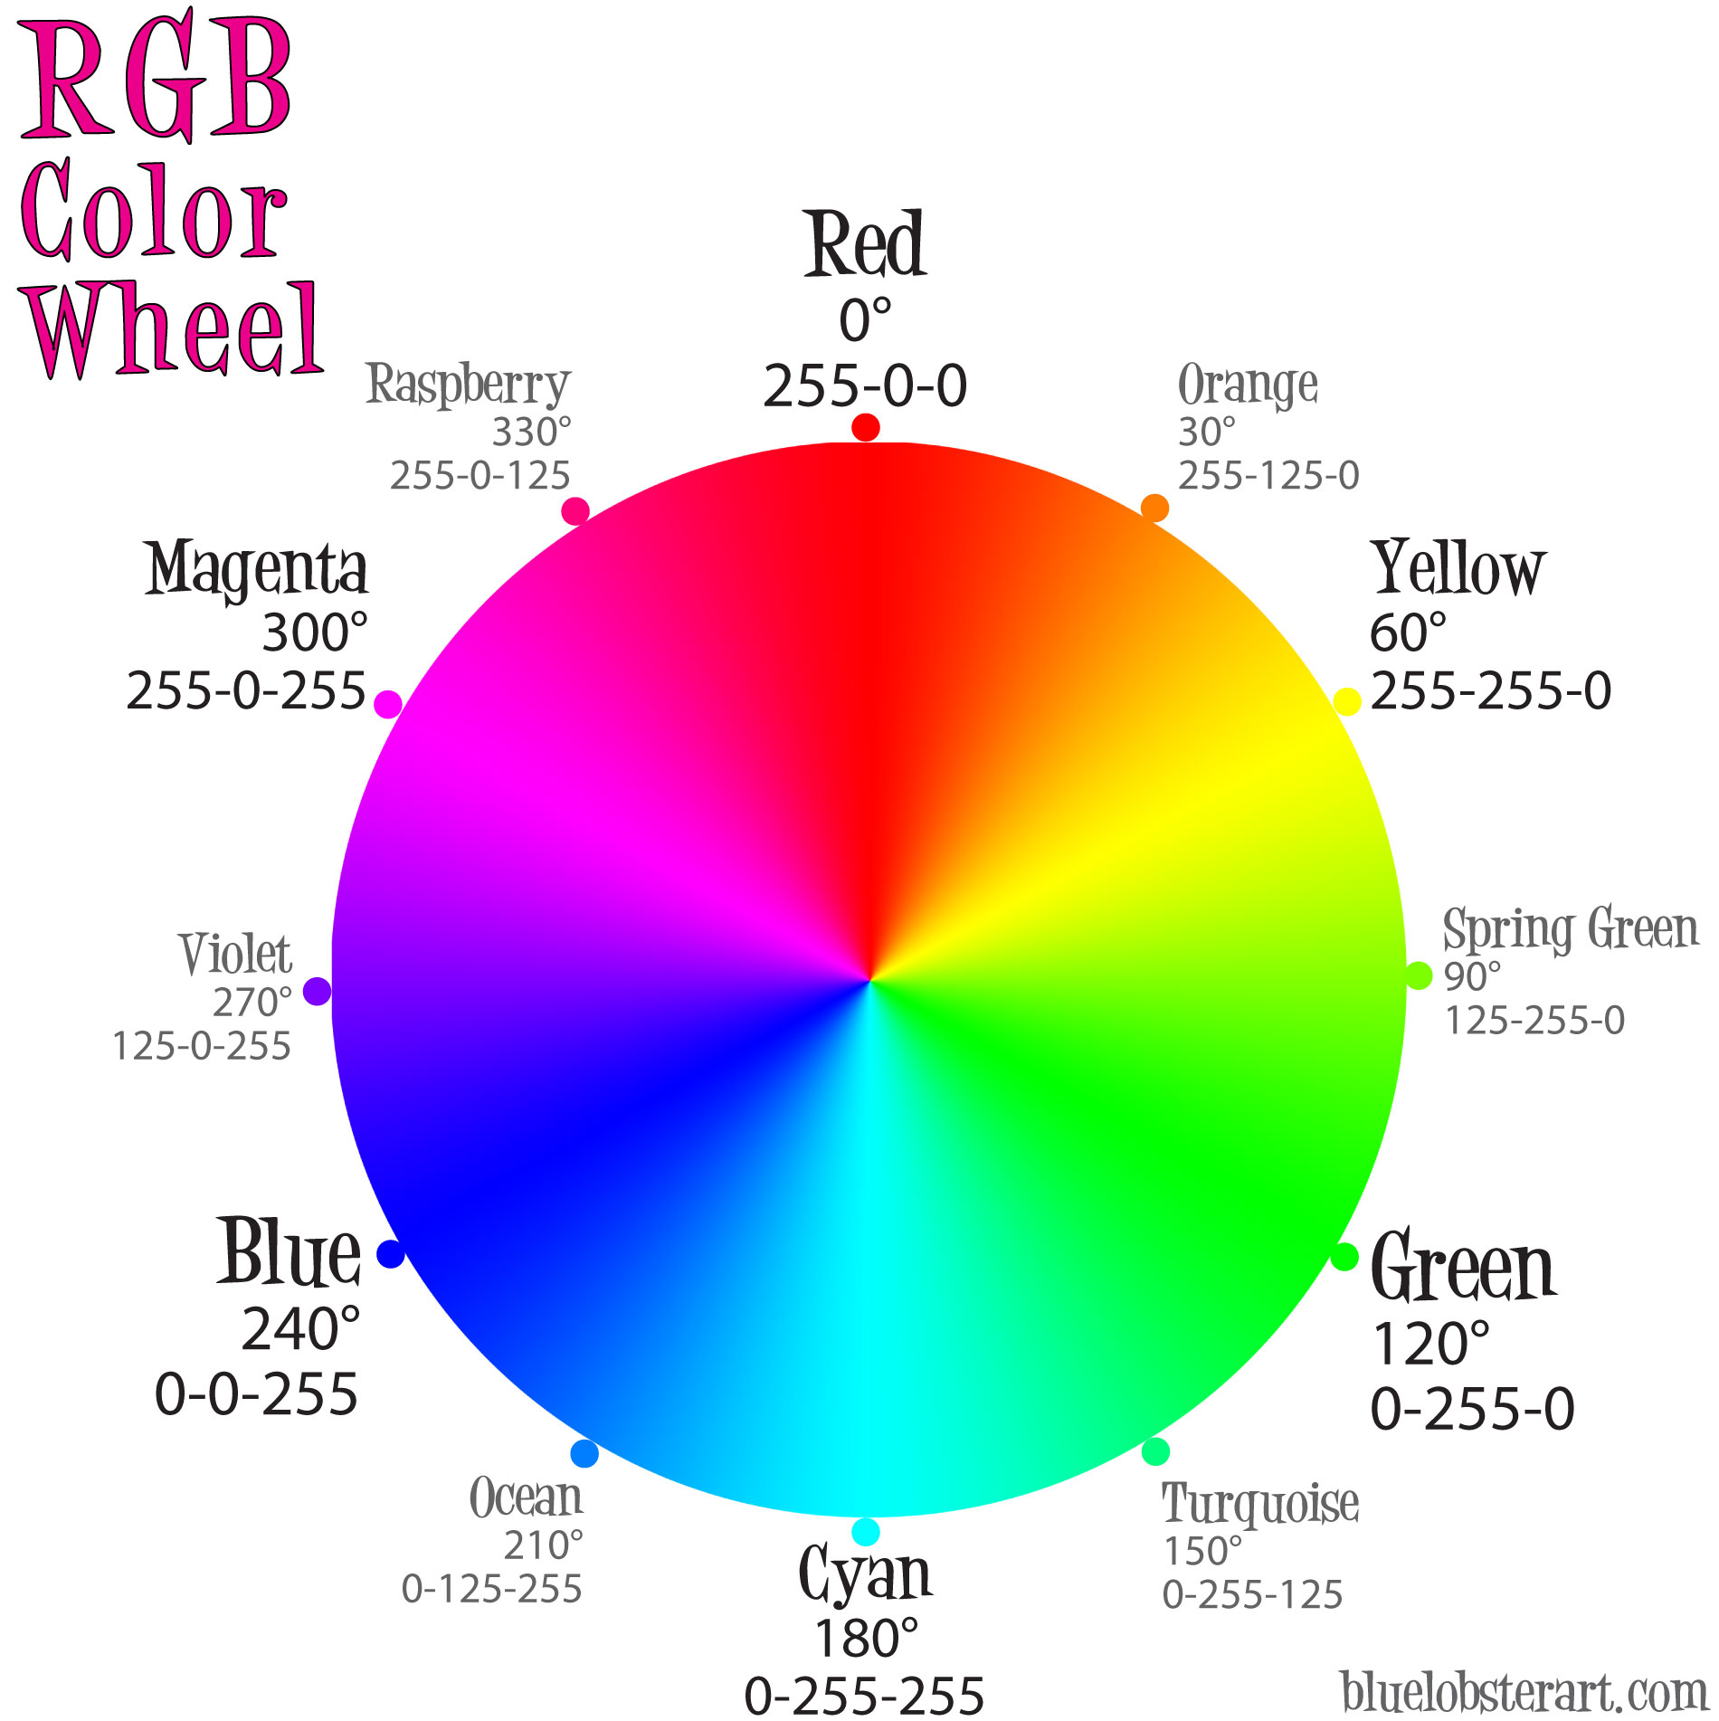
Color Wheel RGB

Slide 8
More Color Support
Since CSS3+ there are support to more color schemes and more ways to use RGB:
RGB: instead of hexadecimal code, we can use the rgb( ) and put the integer values for each color.
Example: color: rgb(0, 255, 0);
RGBA: rgb with alpha between 1 (opaque) and 0 (transparent).
Example: color: rgba(0, 255, 0, 0.4);
HSL and HSLA: using the HSL format (without or with alpha)
Example: color: hsl(120, 100%, 50%);

Slide 9
Incorporating CSS in HTML pages

Slide 10
Style attribute (inline CSS)
Every HTML tag have the style attribute.
This attribute is to define a CSS style for that element.
<p style="color:#0000FF;"> This paragraph is Blue. </p>
<p style="color:#00FF00;text-align:center;"> Now this one is green and centered. </p>

Slide 11
Internal CSS
It is very laborious to format each tag individually using the style attribute (inline CSS).
For this reason, we can declare “style classes” in our HTML document, and reuse the class for different elements.
We make the declaration in the <head> tag, and this style declaration is called “Internal CSS”.

Slide 12
Internal CSS – Style Declaration
We create the style declaration with <style type=“text/css”> </style>.
Don’t forget the “dot” at the begging of each class name.
<style type="text/css"> .blue_text {color:#0000FF;} .big_green { color:#00FF00; font-size:2.5em; } </style>

Slide 13
Internal CSS – Using Classes
Do you remember the attribute “class” that every HTML tag has?
You just put the name of the class you declared before (without the dot).
<p class="blue_text"> This paragraph is blue. </p> <p class="big_green"> On the other hand, this one is green and bigger. </p>

Slide 14
Internal CSS – Changing Tag Format
Internal CSS with style classes are good, but what if we want to change the default formatting behavior of all tags from one type?
We just use the tag name in the style declaration, that will apply the style to every tag.
<style type="text/css"> p {color:#0000FF;} h1{color:#00FF00; font-size:2.5em; text-align:center;} </style>

Slide 15
External CSS
Internal CSS is useful, but what if we want to reuse the same style for different web pages?
We create a separate CSS file and import it in our HTML pages.
A CSS file is a simple text file with the “css” extension.
Please remember, to import the file in the <head> tag.
Syntax for importing in the box bellow:
<link rel="stylesheet" type="text/css" href="my_stylesheet_file.css" />

Slide 16
Styling Id vs Classes
As we saw earlier, we declare style classes using a “dot” and then a name. Example: .blue_text {color:#0000FF;}
We can also style an “id” by using a similar declaration, we use a hash symbol # and then the id name. Example: #menu1 {color:#00FF00;}

Slide 17
Applying several Classes
We can apply more than one style class to a single HTML tag.
Just put the names of the classes separated by spaces inside the class attribute.
<p class="blue_text big_text center_text">
This paragraph would have the classes blue_text, big_text, and center_text applied at the same time. </p>

Slide 18
Nested Styles
We can change the behavior of only the tags that are nested inside another. For example, we may only want to the change the format of links inside a nav, or the paragraphs inside sections.
We declare the styles using spaces for the tags.
<style type="text/css"> nav ul a {color:#FF0000;} section#id1 p{color:#00FFFF;}
</style>

Slide 19
Grouping Styles
If we have different tags with the same style, we can group them together by using a comma “,”.
<style type="text/css"> h1 {color:#008800;} h2 {color:#008800;} p{color:#008800;}
</style>
<style type="text/css"> h1,h2,p{color:#008800;}
</style>

Slide 20
Universal Element for Styles
The asterisk * is the universal element and represents all tags inside the HTML document.
Therefore, if you want a style to be applied to all elements, use the asterisk.
<style type="text/css"> * {color:#FFFF00;} </style>

Slide 21
Cascade of Styles
The styles are always applied in “cascading” order.
The order from lowest to highest priority is:
External CSS element definition
Internal CSS element definition
Class Attribute
Id Attribute
Style Attribute

Slide 22
Basic Concepts

Slide 23
Comments in CSS
We can create comments inside an Internal or External CSS.
Comments cannot be placed inside style and class attributes.
Start comment with /* and end with */
<style type="text/css"> p {color:#0000FF;} /* This here is a comment */ </style>

Slide 24
HTML <span> Tag
How can we format just part of an element without breaking CSS standards?
For example, we want to change part of the text inside a paragraph but not the entire paragraph.
Solution: we use the <span> tag.
The <span> tag does not do anything by itself. But with CSS we can add styles to it, and use it to format part of an element.
<p> This paragraph <span class="attention">
exemplifies </span> what we can do with span. </p>

Slide 25
<div> vs <span>
The tag <div> is commonly used to group a collection tags inside of it.
The tag <span> is commonly used to separate a portion of text inside an element.
Roughly, we could use either in both instances. However, it is considered good practice to follow this standard.

Slide 26
Common Properties

Slide 27
CSS Properties
Some of the most common CSS properties:
Background
Font
Text
Column
Border
Margin
Padding
Width
Height
Position

Slide 28
Background Property
background-color:#000000;
Possible values: color, transparent.
background-image: url(‘filename.png’);
background-repeat: no-repeat;
Indicates if the background image should be repeated.
Possible values: repeat, repeat-x, repeat-y, no-repeat.
background-attachment: scroll;
Indicates if the background image must scroll with the page.
Possible values: fixed, scroll.

Slide 29
Background Property (cont.)
background-position: top right;
Where the background image should be positioned.
Possible values: top left, top center, top right, center left, center center, center right, bottom left, bottom center, bottom right, x% y%, x y.
background-attachment: scroll;
If the background image must scroll with the page.
Possible values: fixed, scroll.
background-size:100px 80px
Possible values: Xpx Ypx, X% Y%, cover, contain, inherit, initial, auto.

Slide 30
Multiple Backgrounds
Added in CSS3, we can place multiple background images.
Each background overlap the other.
The first image in the code is the one which is in “front”.
Use commas in the properties for each image.
background-image:url(‘front.png’),url(‘middle.png’),url(‘back.png’);
background-repeat:no-repeat, no-repeat, repeat;
background-size:120% 120%, 50px 80px, auto;

Slide 31
Font Property
font-family: ”Times New Roman”, serif;
Sets a list of fonts to be used in this element. Put the names of the fonts separated by comma. The browser will display the first available font in the sequence.
font-size: 2.5em;
W3C recommends using “em” unit for font-size (1em = 16 pixels).
Possible values: Xem, Xpx, X%, xx-small, x-small, small, medium, large, x-large, xx-large, smaller, larger.
font-style: italic;
Possible values: normal, italic, oblique.

Slide 32
Font Property (cont.)
font-weight: bold;
Many browsers support a number between 100-900 for bold-weight.
Possible values: normal, bold, bolder, lighter, 100, 200,…, 900.
font-variant: small-caps;
Possible values: normal, small-caps.
font-variant-caps: petite-caps;
Possible values: normal, small-caps, all-small-caps, petite-caps, all-petite-caps, unicase, titling-caps, initial, inherit.

Slide 33
Text Property
text-indent:30px;
Applies an indent to the first line of text (usually a paragraph).
Possible values: Xpx, X%
text-align: center;
Possible values: left, right, center, justify.
text-shadow: 2px 2px 0 #0000FF;
Format: x y blur color
Possible values: above format, none, initial, inherit.

Slide 34
Text Property (cont.)
text-decoration: underline;
Possible values: none, underline, overline, line-through, blink.
text-transform: capitalize;
Changes the text display to lowercase, uppercase, etc.
Possible values: none, uppercase, lowercase, capitalize.
text-overflow: ellipsis;
Defines how to display when the text is bigger than the element.
Possible values: clip, ellipsis, “some text”, initial, inherit.

Slide 35
Column Property
column-count: 2;
Divides the element into columns.
column-gap: 10px;
column-fill: auto;
Possible values: balance, auto, inherit;
column-rule: 1px dotted #00AA00;
A line separating the columns, format: width style color;
column-width: 100px;

Slide 36
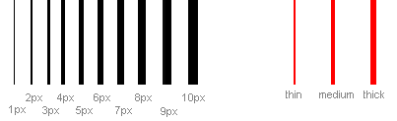
Border Property
Complex property that allows for a great customization of border
border-width: thin;
Defines the thickness of the border
Possible values: thin, medium, thick, Xpx;

Slide 37
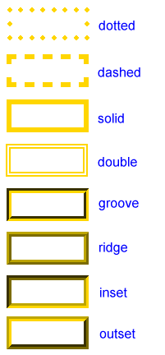
Border Property (cont.)
border-color:#FFFF00;
Possible values: any CSS color.
border-style:double
Possible values: dotted, dashed, solid, double, groove, ridge, inset, outset.
border-image:url(‘border.png’)
Speficies an image to be the border.

Slide 38
Customize Part of the Border
We can change and customize only parts of the border by using their position (left, right, top, bottom) in the middle of the property.
border-style: solid; /* all borders will be solid */
border-width: 3px; /* all borders will have a 3 pixels width */
border-left-color:#0000FF; /*only the left border will be blue */
border-bottom-color:#00FF00; /* only the bottom will be green */
border-right-color:#FF0000; /* only the right border will be red */
border-top-style: dashed; /*the top border will be dashed, while the others will be solid */
border-bottom-width: 1px; /* the bottom will have a 1px width*/

Slide 39
Rounded Borders
Another great addition to CSS3+
border-radius: 25px;
Possible values: Xpx, Xem, Xcm, Xin, X%, initial, inherit.
We can also just round a specific corner by using its coordinate: top-left, top-right, bottom-right, bottom-left.
border-radius: 5px; /* all borders rounded by 5 pixels */
border-top-left-radius: 20px; /* top-left corner rounded by 20px */
border-top-right-radius: 20px; /*top-right corner as well */

Slide 40
Margin Property
Defines the margin, the space outside the border of the element.
Use “margin” followed by a dash and the position (right, left, top, bottom)
Possible values: auto, inherit, Xpx, Xcm, Xin, Xpt, X%.
margin-left: 20px; margin-top: 50px;

Slide 41
Padding Property
Padding is the spacing between the border and the content.
Use “padding” followed by a dash and the position (right, left, top, bottom)
Possible values: auto, inherit, Xpx, Xcm, Xin, Xpt, X%.
padding-left: 20px; padding-bottom: 50px;

Slide 42
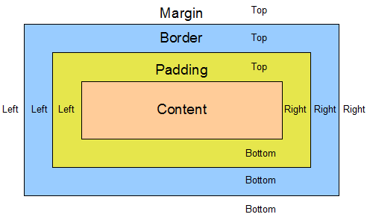
Margin, Border, Padding

Slide 43
Width Property
width: 50%
Sets the standard width of the element, usually in percentage.
min-width: 100px
max-width: 500px
Minimum and maximum width, usually defined in pixels.
Possible values: Xpx, Xcm, Xin, Xpt, X%.

Slide 44
Height Property
height: 50%
Sets the standard height of the element, usually in percentage.
min-height: 100px
max-height: 500px
Minimum and maximum height, usually defined in pixels.
Possible values: Xpx, Xcm, Xin, Xpt, X%.

Slide 45
Mathematical Functions
We can also use mathematical functions min() and max() in CSS.
Mostly used for properties with length (width, height, margin, etc.).
width: max(20px, 500px); padding-left: min(5%, 20px);

Slide 46
Position Property
The Position property itself only defines the method for positioning this element (and not the coordinate)
Possible values: static, relative, fixed, absolute, sticky
To change the coordinate (and actual position) of the elements, we use the properties: top, left, bottom, right.
Example: left:100px;
Possible values: Xpx, Xcm, Xin, Xpt, X%.

Slide 47
Different Positions
position: static
Default, the element is positioned according the flow of page.
The coordinate properties (top, left, bottom, right) has no effect.
position: relative
You can change the position relative to the normal position using the coordinate properties.
position: fixed
It stays where you set (with coordinates) even when scrolled.
position: absolute
It is positioned in absolute measures to its container.
position: sticky
Behaves like relative until it is on the viewport, then it will “stick” to the screen and behave like fixed.

Slide 48
Shorthand Properties (Motivation)
Most CSS properties can be grouped into a category: Background, Font, Border, Margin, …
This grouping is based on the first property name.
Sometimes we have to type a lot for a single property group:
Example: background-color: …; background-image:…; background-repeat:…; background-position:…;

Slide 49
Shorthand Properties
We can type less, by using the main property name and setup several values all at once (as long as you know the correct order)
background:#00FF00 url(fundo.png) top left no-repeat;
margin: 10px 10px 20px 20px; /* top right bottom left*/
padding: 15px 15px;

Slide 50
Common Practices

Slide 51
Pseudo-Classes
Pseudo-classes are used define a special state in the element.
Basic syntax “Element :pseudo-class { css_properties }”
a { text-decoration:none; }
a:hover{ text-decoration:underline; }

Slide 52
Some Pseudo-Classes
Pseudo-Class | Description
:link | Unvisited link
:visited | Visited link
:hover | Element in the mouse hover
:first-child | First child of the element
:nth-child(n) | Selects every “n” child (n can be a #/odd/even).
:focus | Element with the focus (inputs)
:invalid | Selects the input with an invalid value.
:valid | Selects the input with a valid value
:required | Selects the input with a required attribute.

Slide 53
Invisible Elements
The property visible can hide an element.
Possible values: visible, hidden, collapse, inherit.
Even invisible, an element will still occupy the same space it did before. To change that we need to set the property display.
Possible values: inline, none, inherit, block, table, …

Slide 54
Floating Elements
The property float makes the element float to the right/left.
Possible values: none, right, left, inherit.
Floating makes it possible to align several different element horizontally and create interesting visual designs.
Its usage may be challenging for beginners, but with some practice you can master this property.

Slide 55
Floating Example
Suppose a web page divided into 4 parts as follows:
<div id="main">
<nav> … </nav>
<div id="content"> … </div>
</div>
<footer>
…
</footer>

Slide 56
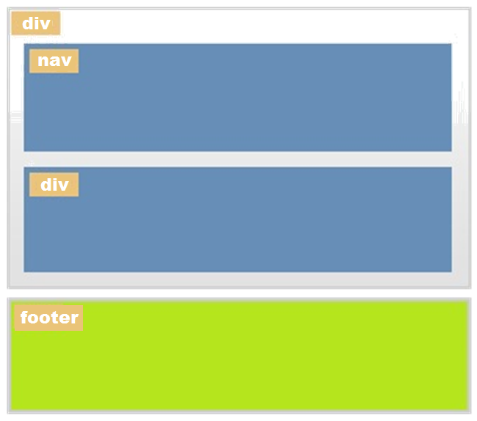
Floating Example: Sketch Display

Slide 57
Floating Example: Adding Float CSS
nav {
width:30%;
float:left;
}
div#content {
width:65%;
float: left;
}
/* You may also want to change the bg color to better distinguish the elements */

Slide 58
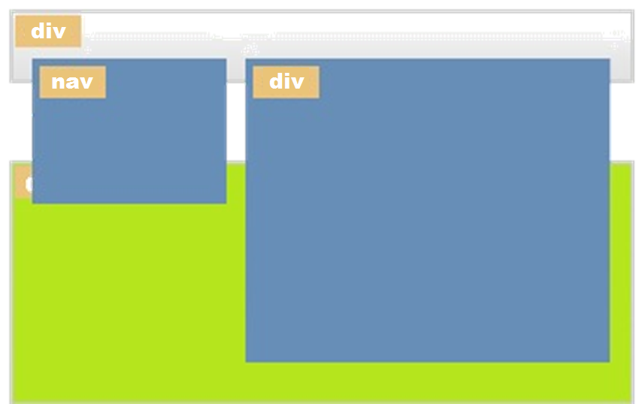
Floating Example: Display after Float

Slide 59
Floating Example: Final Fix
There are many ways to “fix” the float example, the easiest is to add the following code to the main div.
Another way would be to just remove the “float:left” from the content div.
Now you can see the resulting display is much better.
div#main {
display:table;
}

Slide 60
Principles of Web Design

Slide 61
Web Design
When talking about web design, we refer to the all the visual components to compose and maintain a web site.
It involves several different areas of expertise.
Semiotics, communication, business intelligence, graphical design, human-machine interface, information technology, marketing, photography, animation, etc.

Slide 62
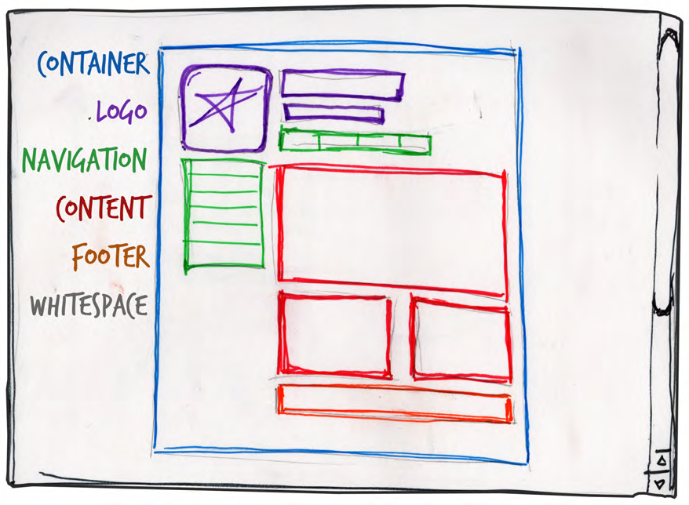
Basic Layout

Slide 63
Web Site Templates
In the W3School, there are a few template designs for websites layouts.
https://www.w3schools.com/css/css_templates.asp

Slide 64
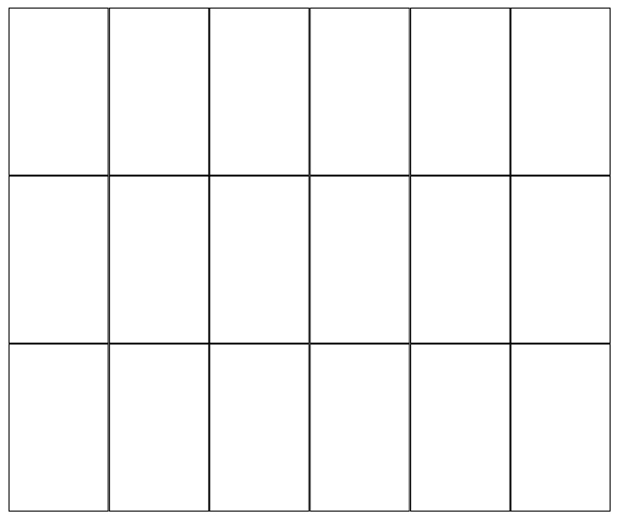
Grid Theory – Rule of Threes
Human perception finds aesthetic pleasing some proportions.
A simple way to accomplish a good design is by a using a grid of Threes.
Create a grid in your web site in multiples of 3.

Slide 65
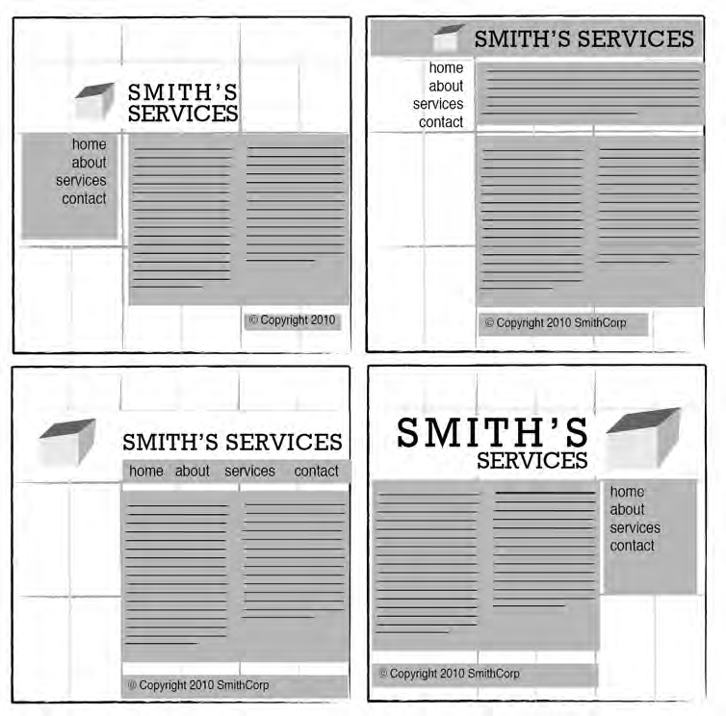
Grid of Threes Examples

Slide 66
Grid of Threes Examples

Slide 67


Color Temperature

Slide 68
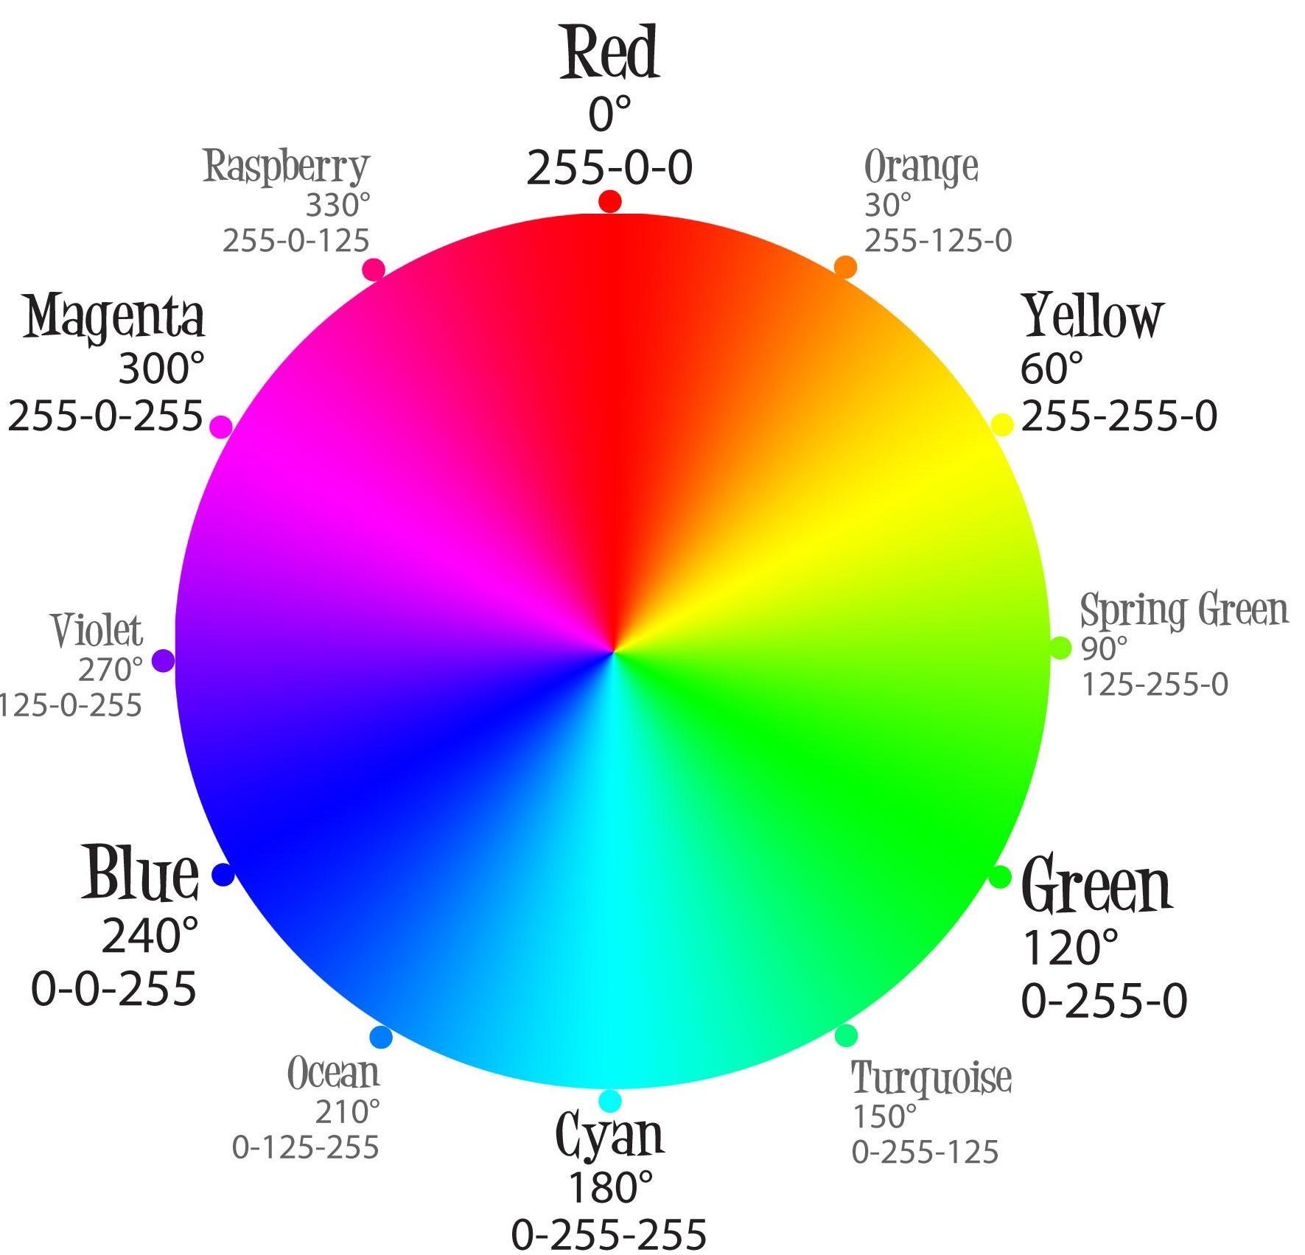
RGB Color Wheel

Slide 69
Color Scheme
Color schemes are harmonic color combinations.
Monochromatic
Analogous
Complementary
Split Complementary
Triadic
Tetradic (or Double Complementary)

Slide 70

Monochromatic
A monochromatic color scheme only uses one color in many different shades and tones.

Slide 71

Monochromatic Example
http://blank.com.pt/
http://www.designjunction.in/
https://mint.intuit.com/
https://www.jwilouvres.com.au/

Slide 72

Analogous
In Analogous, we take adjacent colors in the wheel.
The tricky here, is to not overdo in the number of colors, or else you will give a headache to your users.

Slide 73

Analogous Example

Slide 74


Complementary
We take colors on the opposite sides of the color wheel. This scheme create a good contrast when done well.
Bad Complementary
Good Complementary

Slide 75

Complementary Example

Slide 76
Other Schemes
Split Complementary: We take one color and then the adjacent colors to the opposite color in the wheel.
Tetradic (or Double Complementary): Like a complementary, but instead of taking opposite colors, we take the adjacent colors of the opposites (4 different colors).
Triadic: Make a triangle of equal sides and take those three colors in the wheel.

Slide 77
Color Scheme Tools
Both web sites bellow, give a good reference guide to color schemes and RGB codes for your own designs
https://color.adobe.com/
https://paletton.com/

Slide 78
Final Remarks

Slide 79
CSS Zen Garden
Zen Garden was a good example to show the power of CSS in web page design. It uses the same HTML but different CSS to completely change the appearance.
I highlight “was” because the site is not properly maintained, and there are many broken links.
http://www.csszengarden.com/

Slide 80
References
W3Schools <www.w3schools.com>
W3C School – CSS Tutorial <http://www.w3schools.com/css/css_intro.asp>
Reference List CSS <http://www.w3schools.com/cssref/default.asp>
Beaird, J. and George, J. “The Principles of Beautiful Web Design”, 3rd Edition, 2014.

